Slide 1

Calvin Michele, Ethan Sahlstrom, & Sheng Her

Slide 2



GitHub
Main source of collaboration
Stored files and wrote down outlines
Allowed us to be on same page
Easy to share files, ideas, and plans
Confusing a first, but ended up being a great source

Slide 3
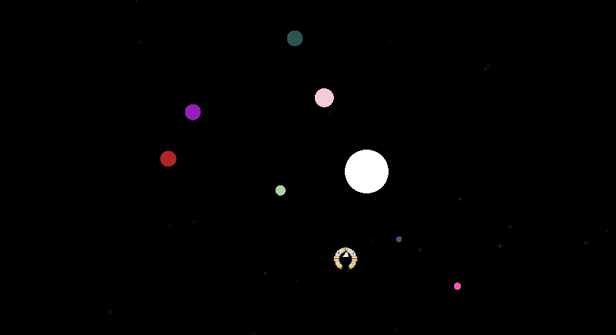
Introduction
Space themed, incremental game
Build more resources to level to get even more resources
Simple goals and missions
Suitable for all ages
Used programming library raylib
GUI

Slide 4

Game
Background
Mort Corp brings people back to life at the cost of a huge monetary debt. Player needs to pay off debt and escape the cycle. If player fails to do so, they will die and fail to escape the cycle.
Objective: Clear debt
Win rewards from mission
Time Limit

Slide 5
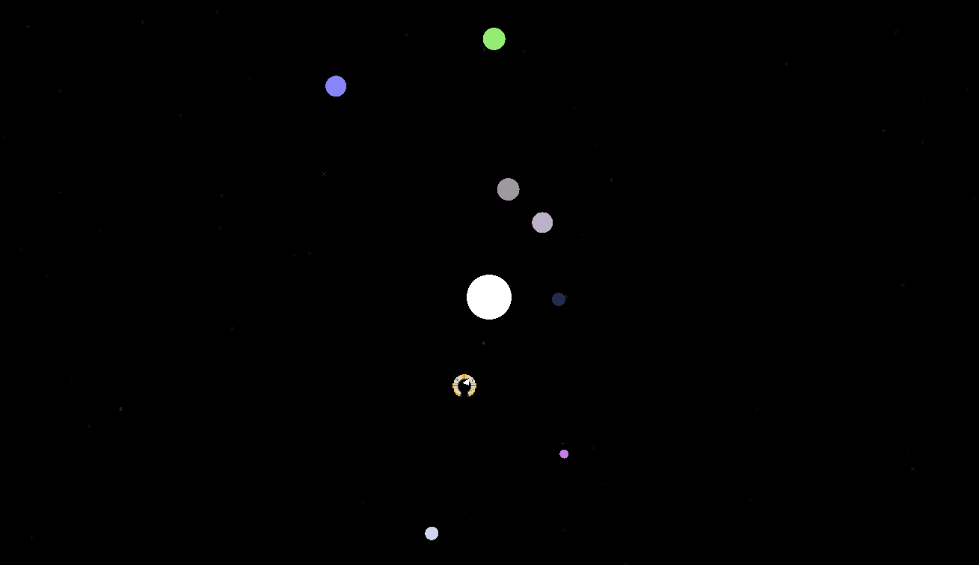
Process
Decided on topic and theme
Wrote an outline
Wrote the code
Implemented it into main.cpp
Test run
Fix code

Slide 6
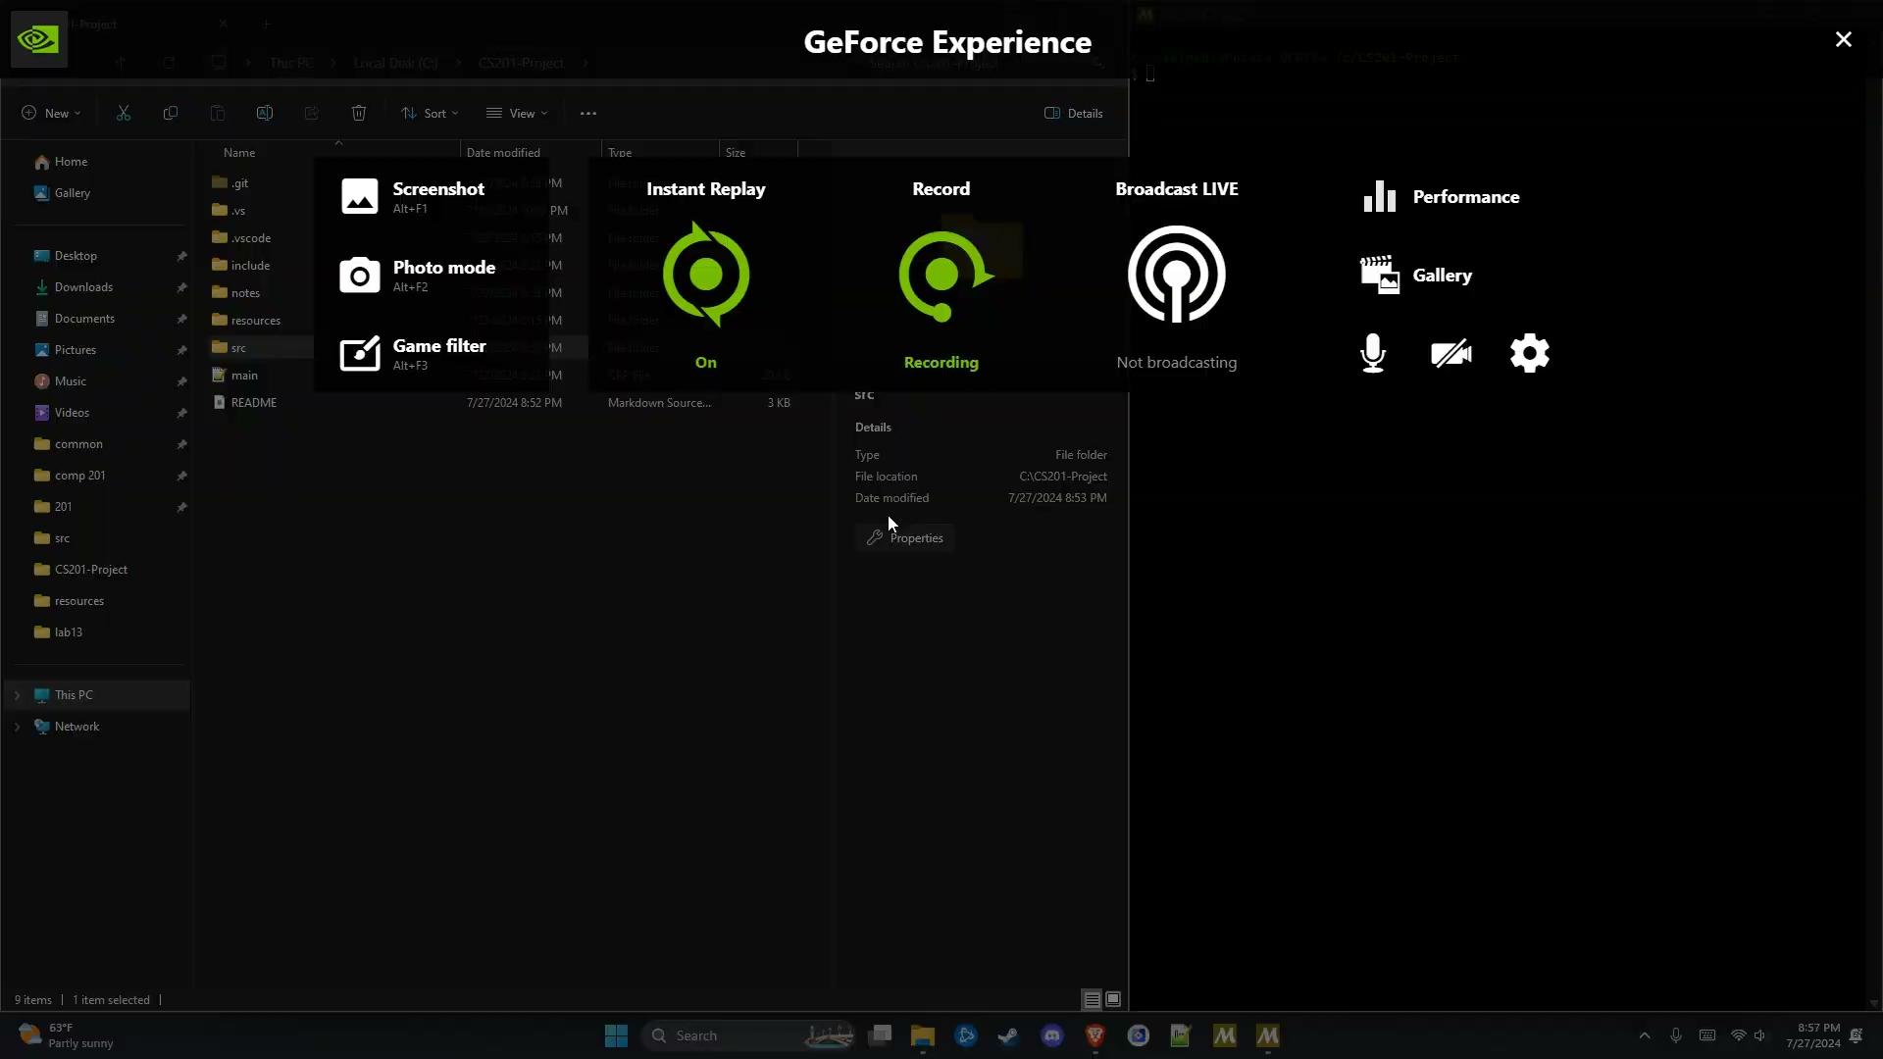

Slide 7

Contributions:
Sheng Her worked on player class, ship.cpp, star.h, shooting star animation, and main screen visuals. She also wrote the abstract, introduction, and github sections in this report.
Calvin Michele was the sole contributor to main.cpp, particles.cpp, solarsystem.cpp, and the resources folder, and contributed to the ship.cpp, marketupgrade.cpp, mission.cpp, star.cpp, and the star.h. He helped revise and write the README.md and wrote the GUI, discarded ideas and regrets, and references sections in this report.
Ethan Sahlstrom contributed to the marketupgrade.cpp, mission.cpp, star.cpp, and the star.h. He helped revise and write the README.md and wrote the Game Loop section of this report.

Slide 8
Credits
Raylib Quick Reference Card, 2024, R. Santamaria, https://www.raylib.com/cheatsheet/cheatsheet.html
Raylib Examples, 2024, https://github.com/raysan5/raylib/tree/master/examples
Raylib Games, 2024, https://github.com/raysan5/raylib-games
Thanks to Ramon Santamaria and contributors for the raylib library and all of its examples to learn from.

